Slide 1
IBM 360 ARCHITECTURE
By
Mithun raghav subramaniam

Slide 2
CONTENTS
INTRODUCTION
CRITICAL ELEMENTS
ARCHITECTURE DETAILS
ADDRESSING MODES AND INSTRUCTION FORMATS
OPERATION ON THE 360/370

Slide 3
INTRODUCTION
The IBM System/360 (S/360) is a mainframe computer system family announced by IBM on April 7, 1964. It was the first family of computers designed to cover the complete range of applications, from small to large, both commercial and scientific.
The goal when creating the IBM 360 was to create a “family concept”, where for the first time a single ISA could be used with older and newer machines in the same family.
The IBM 360 was historically important due to
1. forward and backward compatibility (family concept and extensive instruction set)
2. clear separation between architecture and implementation
3. integration of scientific and business efficiency
4. extensive use of microprogramming

Slide 4
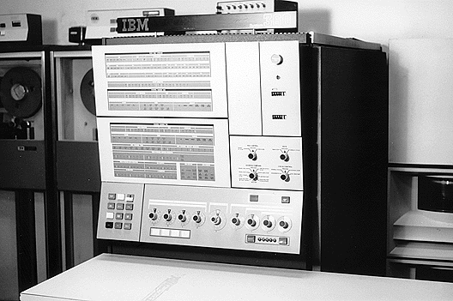

Slide 5
CRITICAL ELEMENTS
Forward and Backward Compatibility
IBM wanted to create “general purpose” computers that were both forward and backward compatible. In doing so, they created small and large computers that could handle the same ISA. They had to find a middle ground between complicated and resource-intensive microinstructions that small computers couldn’t run effectively and simple instructions that didn’t utilize the large computers’ resources. The loss of efficiency in the computers due to compatibility design considerations was far overshadowed by the advantage of compatibility achieved between models. Hence, they could create software that fit a single product line and customers could choose their appropriate machine along this compatible line.
The IBM 360 family of computers created the concept of the ISA , where every machine had the same set of instructions, number of user registers, and behavior, and thus were binary compatible

Slide 7
Clear Separation Between Architecture and Implementation
The various capabilities and resources of one computer in the line versus another required different implementations, while using the same ISA.
IBM used the same architecture throughout many different computers that then needed different implementations
Integration of Scientific and Business Efficiency
Before the IBM 360, computers typically offered performance in either scientific or business constructs.
The IBM 360 family of machines could run the same programs that were on separate computers earlier, but at different speeds.
The tradeoff of performance for the ability to run business and scientific programs on the same machine was worthwhile.
System/360 was designed to be able to handle both decimal and binary formatted information, with both variable-fixed length and floating-point arithmetic capabilities. Since scientific users tended to use Fortran and business users tended to use Cobol, IBM designed and developed the PL/1 programming language in a an attempt to provide a programming bridge between the two communities

Slide 8
Extensive Use of Microprogramming
The architecture of the IBM 360 is built around microprogramming, or small programs of microinstructions. By using microprogramming, smaller and larger computers could accomplish goals of small micro programs with their own implementations and use whichever microinstructions best suited them (most efficiently, that is).
This way the ISA is consistent, but separate efficient microprogramming techniques between models are the only difference. In order to accomplish this, there needs to be an extensive set of microinstructions that all of the different models of computers could use.
Thus, the concept of a CISC (Complex Instruction Set Computing) architecture was created.

Slide 9
The 360/370 Instruction Set Architecture
The IBM System/360 is a 32-bit machine with byte addressability and support for a variety of data types: byte, halfword (16 bits), word (32 bits), doubleword (double-precision real), packed decimal, and unpacked character strings. The System/360 had alignment restrictions, which were removed in the System/370 architecture.
The internal state of the 360 has the following components:
1. Sixteen 32-bit, general-purpose registers: register 0 is special when used in an addressing mode, where a zero is always substituted.
2.Four double-precision (64-bit) floating-point registers.
3.Program status word (PSW) holds the PC, some control flags, and the condition codes.
4.Later versions of the architecture extended this state with additional control registers.

Slide 10
Addressing Modes and Instruction Formats
The 360/370 has five instruction formats. Each format is associated with a single addressing mode and has a set of operations defined for that format. While some operations are defined in multiple formats, most are not.
RR (register-register )
RX (register-indexed)
RS (register-storage )
SI (storage-immediate)
SS (storage-storage)

Slide 11
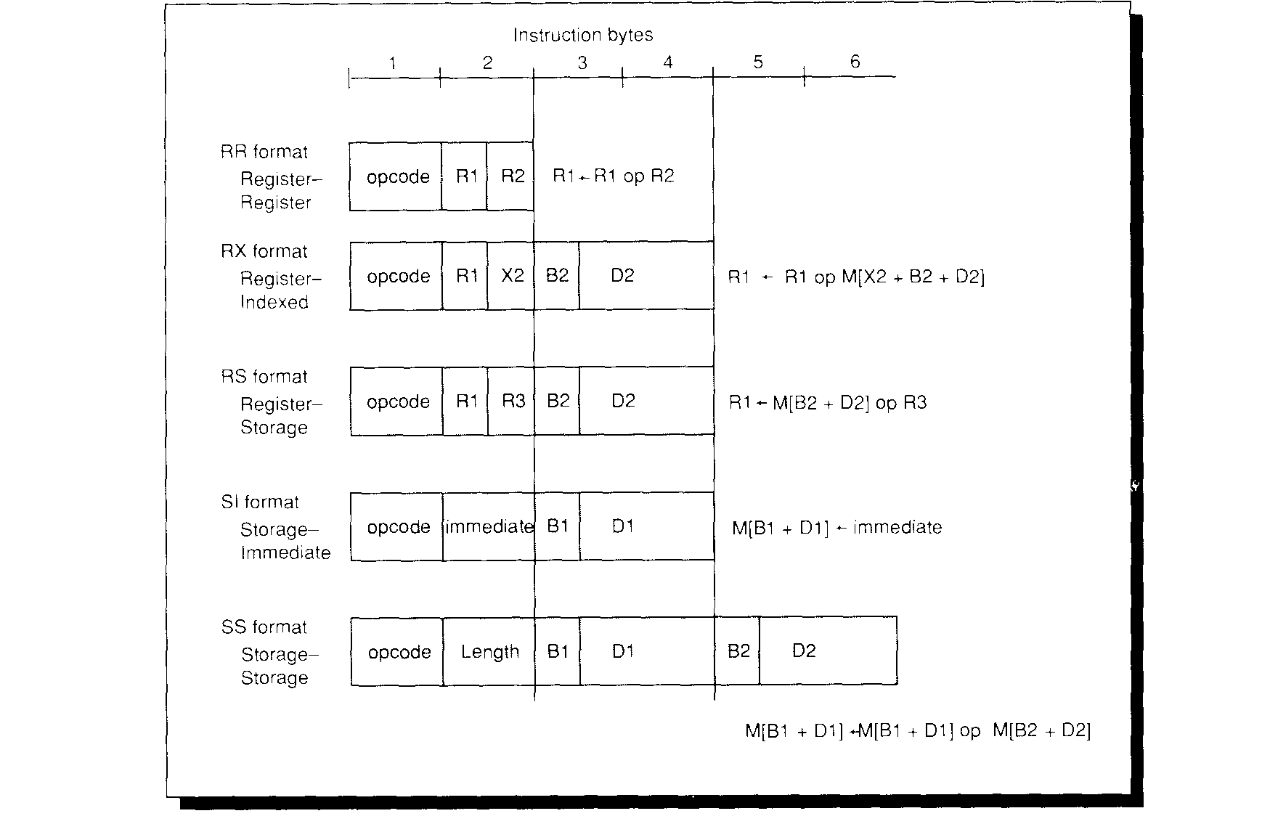

Slide 12
Operations on the 360/370
The instructions on the 360 can be divided into classes. Four basic types of operations on data are supported:
1. Logical operations on hits, character strings, and fired words. These are mostly RR and RX formats with a few RS instructions.
2. Decimal or character operations on strings of characters or decimal digits. These are SS format instructions.
3. Fixed-point binary arithmetic. This is supported in both RR and RX formats.
4. Floating-point arithmetic. This is supported primarily with RR and RX instructions.
Branches use the RX instruction format with the effective address specifying the branch target. Since branches are not PC-relative, a base register may need to be loaded to specify the branch target. This has a rather substantial impact: in general, it means that there must be registers that point to every region containing a branch target. The condition codes are set by all arithmetic and logical operations. Conditional branches test the condition codes under a mask to deter-mine whether or not to branch.

Slide 13
IBM System z10
IBM System z10 is the latest line of IBM mainframes. The z10 Enterprise Class (EC) was announced on February 26, 2008. On October 21, 2008, IBM announced the z10 Business Class (BC), a scaled down version of the z10 EC. The System z10 represents the first model family powered by the z10 quad core processing engine and the first to implement z/Architecture 2 (ARCHLVL 3).
New Features
Cryptography
Decimal Floating Point
New Instructions
New Architecture Level Set (ALS)
z/VM LPAR Support
Capacity On Demand Enhancements

Slide 14
z/Architecture, initially and briefly called ESA Modal Extensions (ESAME), refers to IBM's 64-bit computing architecture for the current generation of IBM mainframe computers. IBM introduced its first z/Architecture-based system, the zSeries Model 900, in late 2000. Later z/Architecture systems included the IBM z800, z990, z890, System z9 and the System z10. z/Architecture retains backward compatibility with previous 32-bit-data/31-bit-addressing architecture ESA/390 and its predecessors all the way back to the 32-bit-data/24-bit-addressing System/360.

Slide 15
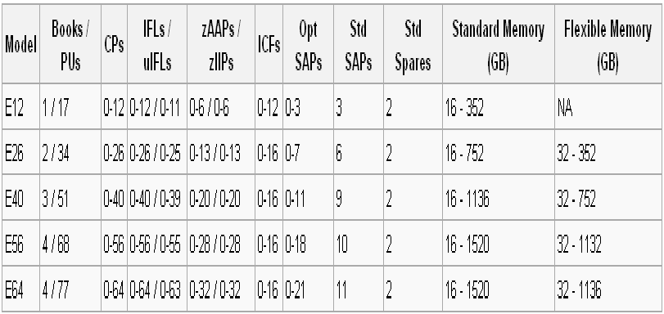
Enterprise Class

Slide 16
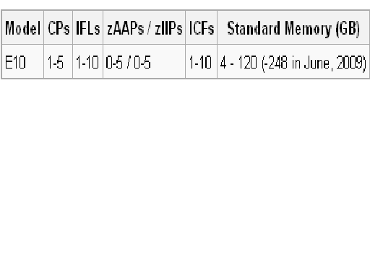
Business Class

Slide 17
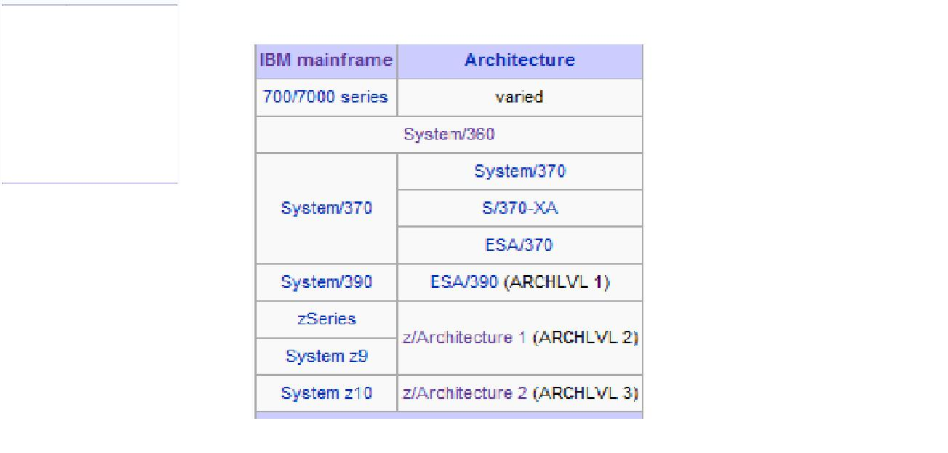

Slide 18
Reference
http://en.wikipedia.org/wiki/IBM_System/360
http://domino.watson.ibm.com/tchjr/journalindex.nsf/ResSubject?OpenView&RestrictToCategory=IBM%20System/360
http://cis.poly.edu/cs2214rvs/ibm.htm
http://www.beagle-ears.com/lars/engineer/comphist/ibm360.htm
http://www-sst.informatik.tu-cottbus.de/~db/doc/People/Broy/Software-Pioneers/Brooks_new.pdf

